Slide 1
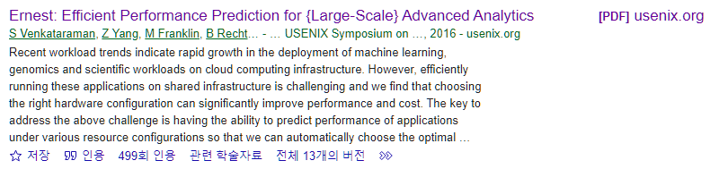
Ernest: Efficient Performance Prediction for Large-Scale Advanced Analytics
Venkataraman, Shivaram, et al.
13th USENIX Symposium on Networked Systems Design and Implementation (NSDI 16). 2016.
22.11.22.
Cloud Computing
Sohee Kim
Notes:
Venkataraman, Shivaram, et al. "Ernest: Efficient Performance Prediction for {Large-Scale} Advanced Analytics." 13th USENIX Symposium on Networked Systems Design and Implementation (NSDI 16). 2016.
https://www.usenix.org/system/files/conference/nsdi16/nsdi16-paper-venkataraman.pdf
https://www.youtube.com/watch?v=dTfkBkkakOM&t=39s

Slide 2
1. Introduction
Venkataraman, Shivaram, et al. "Ernest: Efficient Performance Prediction for {Large-Scale} Advanced Analytics." 13th USENIX Symposium on Networked Systems Design and Implementation (NSDI 16). 2016.
Workload trends : advanced analytics (machine learning, genomics, scientific)
Challenge : predicting the most efficient configuration for large advanced analytics applications in a heterogeneous multi-tenant environments
User’s goal : Minimizing the running time given a budget / Meeting a deadline while minimizing the cost
Performance model
data
Job
Ernest (A performance prediction framework for large scale analytics)
A new approach that can accurately predict the performance of a given analytics job
The main idea is to run a set of instances of the entire job on samples of the input, and use the data from these training runs to create a performance model.
Black box jobs → but works well
Has low overhead (takes much less time and resources to run the training jobs than running the job itself)
Optimal experiment design : statistical technique to select the most useful data points for training
How Ernest can detect when a model isn’t appropriate and how small extensions can be used to model complex workloads
Execution experiments on Amazon EC2 → accurate for a variety of algorithms, input sizes, and cluster sizes.
Notes:
대역폭 Bandwith : 일정 시간 동안 해당 버스를 통해 전송될 수 있는 데이터의 양
워크로드 Workload : 주어진 기간에 시스템에 의해 실행되어야 할 직업의 할당량. 애플리케이션을 지원하는 스토리지 객체. the amount of work an individual has to do
Recent workload trends indicate rapid growth in the deployment of machine learning, genomics and scientific workloads on cloud computing infrastructure
In this paper, they address the challenge of choosing the configuration to run large advanced analytics applications in heterogeneous multi-tenant environments.
The choice of configuration depends on the user’s goals which typically includes either minimizing the running time given a budget or meeting a deadline while minimizing the cost.
The key to address this challenge is developing a performance prediction framework that can accurately predict the running time on a specified hardware configuration, given a job and its input.
So they propose a new approach that can accurately predict the performance of a given analytics job named Ernest.
The main idea is to run a set of instances of the entire job on samples of the input, and use the data from these training runs to create a performance model.
Despite the fact that this is a black-box approach. It works surprisingly well in practice.
This approach has low overhead, as in general it takes much less time and resources to run the training jobs than running the job itself.
The cost and utility of training data points collected is important for low-overhead prediction and we address this problem using optimal experiment design, a statistical technique that allows us to select the most useful data points for training.
They show how Ernest can detect when a model isn’t appropriate and how small extensions can be used to model complex workloads. •
Using execution experiments on Amazon EC2, they show that Ernest is accurate for a variety of algorithms, input sizes, and cluster sizes.
The reason this approach works so well is because many advanced analytics workloads have a simple structure and the dependence between their running times and the input sizes or number of nodes is in general characterized by a relatively small number of smooth functions.

Slide 3
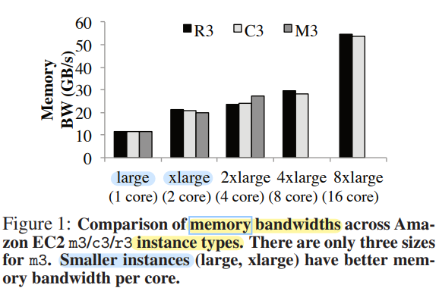
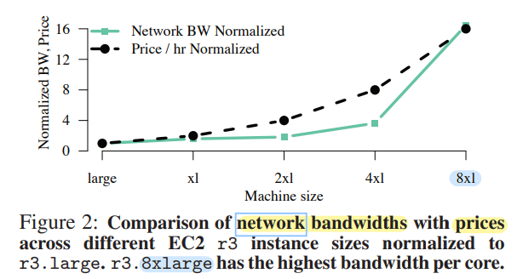
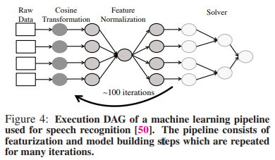
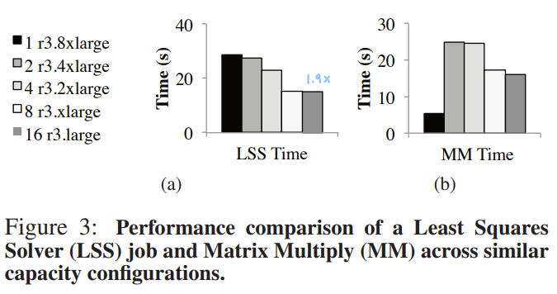
2. Background
Venkataraman, Shivaram, et al. "Ernest: Efficient Performance Prediction for {Large-Scale} Advanced Analytics." 13th USENIX Symposium on Networked Systems Design and Implementation (NSDI 16). 2016.
Hardware Trends
Workload trends
Instance types
R3, C3, M3
Properties
Numerically Intensive
Iterative (each iteration many jobs)
Long running -> expensive
Instance types
R3, C3, M3
Need to choose Instance types and Number of instances
Notes:
recent hardware and workload trends for large scale data analysis
Instance types vary not only in capacity (i.e. memory size, number of cores etc.) but also in performance.
For example, we measured memory bandwidth and network bandwidth across a number of instance types on Amazon EC2.
From Figure 1 we can see that the smaller instances i.e. large or xlarge have the highest memory bandwidth available per core while Figure 2 shows that 8xlarge instances have the highest network bandwidth available per core.
The non-linear relationship between price vs. performance is not only reflected in micro-benchmarks but can also have a significant effect on end-to-end performance.
For example, we use two machine learning kernels: (a) A least squares solver used in convex optimization [37] and (b) a matrix multiply operation [75], and measure their performance for similar capacity configurations across a number of instance types.
The results (Figure 3(a)) show that picking the right instance type can improve performance by up to 1.9x at the same cost for the least squares solver.
Next, we look at workload trends in large scale data analysis and how we can exploit workload characteristics for performance prediction.

Slide 4
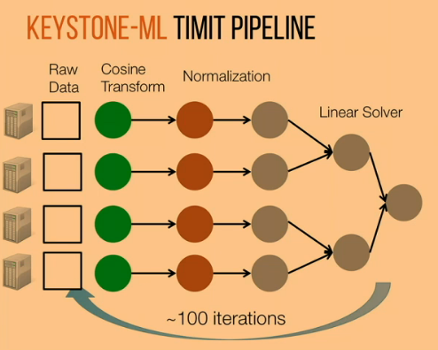
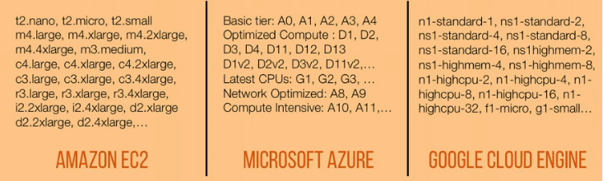
2. Background
Venkataraman, Shivaram, et al. "Ernest: Efficient Performance Prediction for {Large-Scale} Advanced Analytics." 13th USENIX Symposium on Networked Systems Design and Implementation (NSDI 16). 2016.
System side
Properties
Numerically Intensive
Iterative (each iteration many jobs)
Long running -> expensive

Slide 5
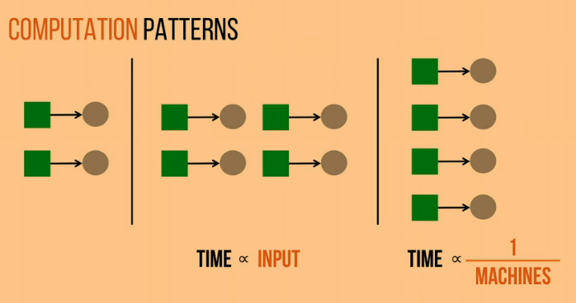
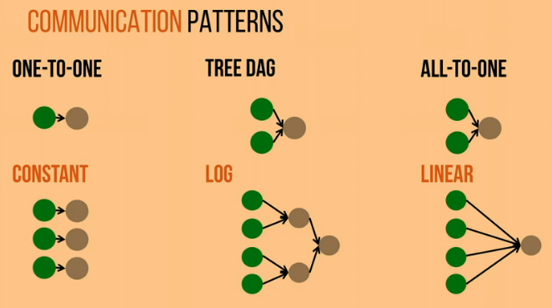
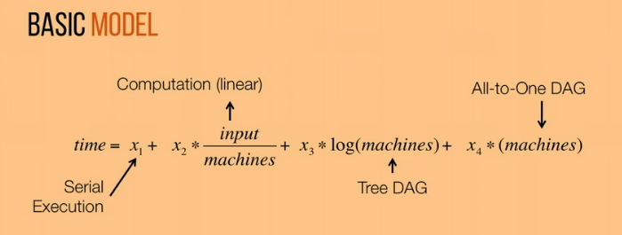
3. Modeling Advanced Analytics Jobs
Venkataraman, Shivaram, et al. "Ernest: Efficient Performance Prediction for {Large-Scale} Advanced Analytics." 13th USENIX Symposium on Networked Systems Design and Implementation (NSDI 16). 2016.
Total time
Computation
Communication
Computation
Computation
Basic model
$$time\text{=}θ_{0}+θ_{1}×(scale×\frac{1}{machines}\text{)+}θ_{2}×\log\left(machines\right)+θ_{3}×machines$$
Notes:
When input times 2. time also times 2
Collect Training Data, fit linear regression

Slide 6
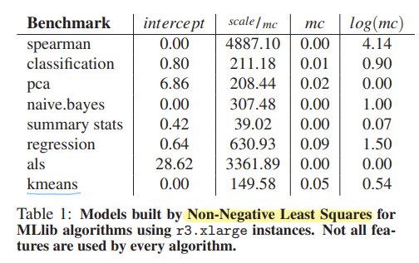
Venkataraman, Shivaram, et al. "Ernest: Efficient Performance Prediction for {Large-Scale} Advanced Analytics." 13th USENIX Symposium on Networked Systems Design and Implementation (NSDI 16). 2016.
3. Modeling Advanced Analytics Jobs
Total time
Computation
Communication
Notes:
When input times 2. time also times 2
Collect Training Data, fit linear regression

Slide 7
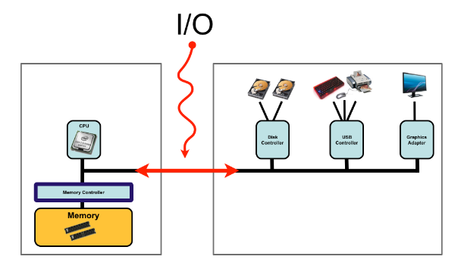
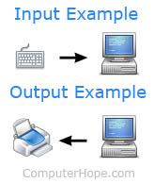
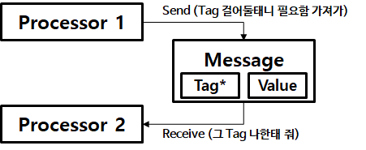
2. Background and related work
Brown, Kevin A., et al. "Interference between I/O and MPI traffic on fat-tree networks." Proceedings of the 47th International Conference on Parallel Processing. 2018.
I/O Traffic (Input/Output)
Split I/O request into fixed-sized chunks – better pipeline and parallelize requests
How I/O requests can cause congestion on the storage severs as well as on the network -> degrade performance
None of studies have evaluated the effect of I/O congestion, mitigation techniques on non-I/O jobs that share network
MPI Traffic (Message Passing Interface)
Most HPC applications use the MPI for communication and their performance can be sensitive to communication latency
Congestion due to MPI traffic within the same application -> degrade performance
HPC applications generate a wide range of message sizes at a wide range of communication frequencies. -> impact congestion caused by MPI traffic
> Message Passing
https://jongmin92.github.io/2019/02/18/Programming/computer-structure/
https://next-brain.tistory.com/32
Notes:
For background, I’ll explain about I/O traffic and MPI traffic.
(Lustre) One study splitted I/O requests into fixed-sized chunks in order to better pipeline and parallelize requests
Notable I/O optimization studies have shown how I/O requests can cause congestion on the storage servers as well as on the network, specifically on links that are directly connected to I/O servers.
This congestion degrades the performance of I/O jobs, and various techniques such as I/O prefetching, buffering, scheduling, and throttling have been proposed to mitigate this degradation. However, none of these studies have evaluated the effect of I/O congestion, and that of mitigation techniques on non-I/O jobs that share the network.
Most HPC applications use the Message Passing Interface (MPI) for communication and their performance can be sensitive to communication latency. Optimized MPI libraries attempt to ensure that sensitive communication tasks on the application’s critical path are not delayed unnecessarily.
However, it is common to observe congestion due to MPI traffic within the same application which can degrade performance [4, 24].
Several surveys of representative MPI workloads have indicated that HPC applications generate a wide range of message sizes from small (few KBs) to large (few MBs) at a wide range of communication frequencies [7, 13]. These characteristics of application communication patterns impact the congestion caused by MPI traffic, and therefore, should be considered when characterizing MPI performance.

Slide 8
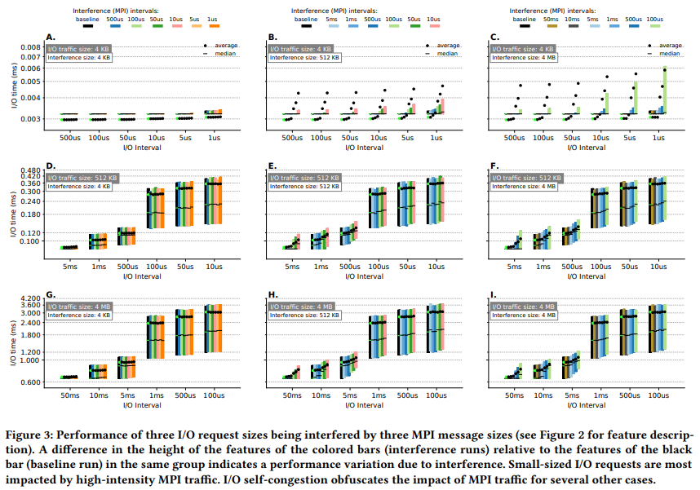
3. Characterization of interference
Brown, Kevin A., et al. "Interference between I/O and MPI traffic on fat-tree networks." Proceedings of the 47th International Conference on Parallel Processing. 2018.
I/O job
The latency of small I/O requests is sensitive to high-intensity MPI interference
Not affected
Increase
(1.9X slowdown)
4 KB
The increase is not due to the presence of MPI traffic
512 KB
No interference
I/O-congestion threshold
4 MB
An increase in the MPI traffic intensity causes a corresponding increase in the I/O request times
4 KB
512 KB
4 MB
Notes:
In order to characterize the interference between MPI and I/O traffic, they should not only capture the extent of the interference, but should also understand how the distinctive features of the traffic patterns result in different interference patterns.
This section presents the resulting trends when different MPI and I/O traffic patterns interfere with each other
This Figure shows the I/O performance when different I/O request sizes interact with different MPI message sizes.
Black bars are baseline, that show the I/O request time when there is no MPI interference.
Chart A shows no significant changes in the position of the dots and bars within any cluster, indicating that the performance of 4 KB I/O requests is not affected by 4 KB MPI background interference.
However, when the size of the interfering messages increases to 4 MB, as shown in Chart C, the latency of 4 KB requests increases significantly.
This demonstrates that the latency of small I/O requests is sensitive to high-intensity MPI interference.
In Charts D-I, there is a significant increase in the I/O times for the rightmost three clusters. As this increase also occurs for the black baseline bars, which show the runtimes when there is no interference, the increase is not due to the presence of MPI traffic.
We will refer to the I/O interval around which this rapid increase in request time happens as the I/O-congestion threshold.
I/O-congestion threshold is between 500- 100 µs for 512 KB requests and between 5-1 ms for 4 MB requests.
When the interfering MPI message size is 512 KB (Charts B, E, H) and 4 MB (Charts C, F, I), an increase in the MPI traffic intensity causes a corresponding increase in the I/O request times before the I/O-congestion threshold is reached.
- Graph I shows
an increase in the MPI traffic intensity causes a corresponding increase in the I/O request times before the I/O-congestion threshold is reached.
Once we cross the I/O-congestion threshold at 1 ms I/O intervals, the interfering MPI traffic does not show a significant impact on I/O performance.

Slide 9
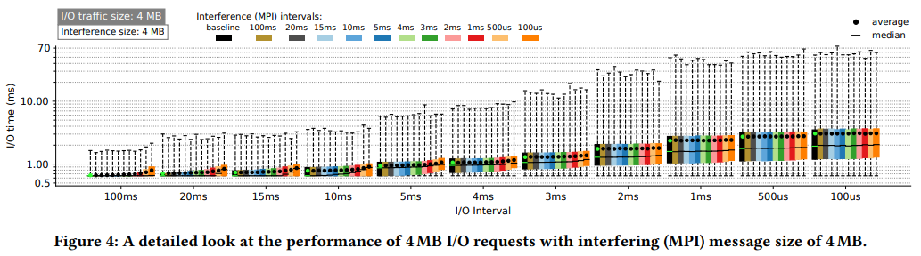
3. Characterization of interference
Brown, Kevin A., et al. "Interference between I/O and MPI traffic on fat-tree networks." Proceedings of the 47th International Conference on Parallel Processing. 2018.
I/O job
4 MB
I/O-congestion threshold
The impact of interference caused by MPI gradually declines as the I/O interval approaches the I/O congestion threshold.
Different I/O request sizes exhibit a similar pattern around their I/O-congestion threshold.
If the time per I/O request is more important than the volume of requests for an I/O job, it is better to send less frequent requests despite the higher relative impact of interference from MPI.
Notes:
Figure 4 presents a more detailed view of the case in which 4 MB I/O requests interact with 4 MB MPI messages.
The inclusion of additional intervals shows that the impact of interference caused by MPI gradually declines as the I/O interval approaches the I/Ocongestion threshold.
At the 2 ms I/O interval, there is minimal increase in the average and 75th percentile time within the cluster.
Nevertheless, after the I/O-congestion threshold is reached, even the baseline is higher than the interference runs prior to the threshold.
The detailed trends seen here can be used to represent the behavior of different I/O request sizes as Figure 3 suggests that
different I/O request sizes exhibit a similar pattern around their I/O-congestion threshold.
Overall, we conclude that if the time per I/O request is more important than the volume of requests for an I/O job, it is better to send less frequent requests despite the higher relative impact of interference from MPI.

Slide 10
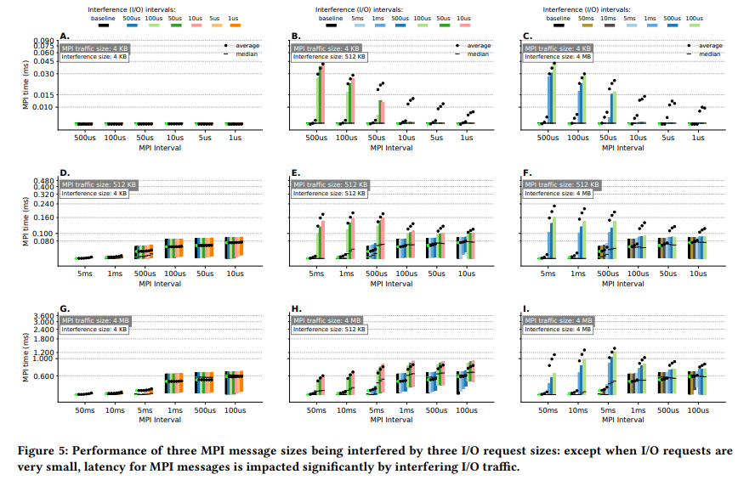
3. Characterization of interference
Brown, Kevin A., et al. "Interference between I/O and MPI traffic on fat-tree networks." Proceedings of the 47th International Conference on Parallel Processing. 2018.
MPI job
Reducing the interval between MPI messages reduces the average slowdown due to interference
4 KB
No variation
Slowdown
Higher I/O injection rates and larger I/O request sizes cause more network congestion and result in more I/O packets stalled and waiting in the buffers of network switches.
512 KB
Overall decreases
4 MB
Reduction in MPI messaging interval results in MPI packets preempting some of the I/O packets, which in turn slows down injection rate for I/O traffic.
4 KB
512 KB
4 MB
Notes:
The performance results for MPI traffic in the presence of I/O interference are shown in Figure 5.
Chart A indicate that there is relatively no MPI performance variation for 4 KB messages in presence of 4 KB I/O requests irrespective of their intervals.
However, as the size of I/O requests increases in Charts B and C, MPI slowdown is observed with a maximum slowdown of 7.6× due to 4 MB I/O requests
Chart C shows that the overall height of each cluster decreases as the MPI interval is reduced as we move from left to right in that chart.
. This, surprisingly, indicates that reducing the interval between MPI messages reduces the average slowdown due to interference
This is visible in all charts where I/O interference size is 512KB, or 4MB.
Higher I/O injection rates and larger I/O request sizes cause more network congestion and result in more I/O packets stalled and waiting in the buffers of network switches.
We hypothesize that reduction in MPI messaging interval results in MPI packets preempting some of the I/O packets, which in turn slows down injection rate for I/O traffic.
With less I/O packets in the system, MPI packets spend less time queued in the network and are transferred faster, which results in overall better MPI performance

Slide 11
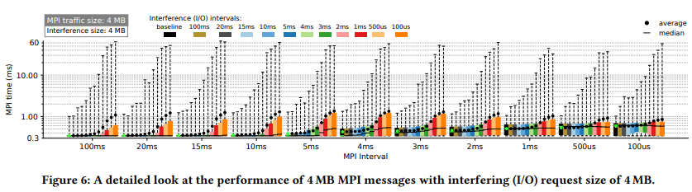
3. Characterization of interference
Brown, Kevin A., et al. "Interference between I/O and MPI traffic on fat-tree networks." Proceedings of the 47th International Conference on Parallel Processing. 2018.
MPI job
4 MB
1.34ms
0.85ms
Reducing the MPI interval improves the MPI performance during high-intensity interference.
All MPI intervals larger than 4 ms experience a maximum slowdown above 300% of the baseline times when the I/O interval is 100 µs.
Summarize
Small interfering requests/messages (4 KB of MPI or I/O) have minimal impact on MPI or I/O performance.
For I/O performance, the impact of interference is moderate if the I/O interval is larger than the I/O-congestion threshold. Below the threshold, interference has negligible effect.
For MPI performance, interference causes variations even when there is a moderate amount of interfering I/O traffic. The most significant impact is observed when the I/O traffic has passed its I/O-congestion threshold.
Overall, the impact of interference is higher for MPI than I/O.
Notes:
To get a more detailed view of MPI performance characteristics, we study the scenario in which 4 MB MPI messages are transferred alongside 4 MB I/O requests in Figure 6.
As described in the previous paragraph, reducing the MPI interval improves the MPI performance during high-intensity interference.
When the I/O interference interval is 100 µs, the average message time for 4 ms MPI interval is 1.34 ms while the average message time for 100 µs MPI interval is 0.85 ms. All MPI intervals larger than 4 ms experience a maximum slowdown above 300% of the baseline times when the I/O interval is 100 µs.
Overall, the results so far can be summarized as follows:
• Small interfering requests/messages (4 KB of MPI or I/O) have minimal impact on MPI or I/O performance.
• For I/O performance, the impact of interference is moderate if the I/O interval is larger than the I/O-congestion threshold. Below the threshold, interference has negligible effect.
• For MPI performance, interference causes variations even when there is a moderate amount of interfering I/O traffic. The most significant impact is observed when the I/O traffic has passed its I/O-congestion threshold.
• Overall, the impact of interference is higher for MPI than I/O

Slide 12
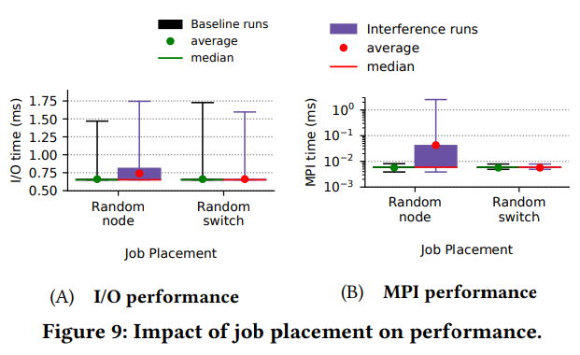
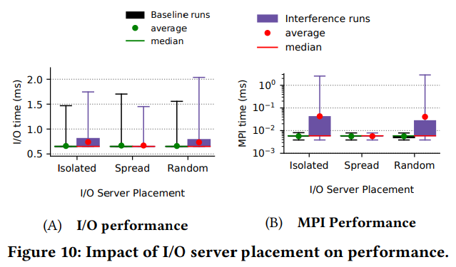
4. Mitigation strategies
Brown, Kevin A., et al. "Interference between I/O and MPI traffic on fat-tree networks." Proceedings of the 47th International Conference on Parallel Processing. 2018.
Job Placement
I/O server Placement
Increase(11.8%)
Increase
(800%)
similar
similar
Random switch :
Improvements - All links connected to switches with I/O servers and clients carry only I/O traffic
Therefore, MPI-I/O interference on links between level1 and level-2 switches is avoided.
The spread-target placement of I/O nodes is best at mitigating interference for both types of jobs
The I/O traffic is confined to a subset of the network and thus does not interfere with the MPI traffic
Notes:
So far, I have presented results on the impact of I/O-MPI interference on the performance of MPI and I/O jobs.
Next, they explore techniques that can potentially mitigate the effect of such interference for the most impacted scenarios.
In particular, we explore three interference mitigation strategies: (i) modifying the placement of jobs to nodes, (ii) relocating the I/O servers, and (iii) throttling I/O traffic.
Figure 9A and Figure 9B show I/O and MPI performance, respectively, for executions with and without I/O-MPI interference for the Random-node and Random-switch job placement schemes.
With the Random-switch placement, we see that the I/O and MPI times for the baseline and interference runs are similar, indicating that there is minimal slowdown due to interference for this type of mapping.
In contrast, for the Random node placement, the average I/O request time increases by 11.8% and the standard deviation increases from 8% to 19% when I/O-MPI interference is present.
And MPI messages experience an average slowdown of 800% with the Random-node placement, and the maximum message time increases by two orders of magnitude
The Random-switch scheme leads to performance improvements because all links connected to switches with I/O servers and clients carry only I/O traffic;
Therefore, MPI-I/O interference on links between level1 and level-2 switches is avoided.
Figure 10 shows the impact of MPII/O interference on performance when the I/O server placement is varied.
They find that the spread-target placement of I/O nodes is best at mitigating interference for both types of jobs. Further, the isolated-target and random-target server placements result in similar slowdown for both jobs.
As a result, the I/O traffic is confined to a subset of the network and thus does not interfere with the MPI traffic.
This insight can guide the placement of LNET routers and burst buffers to leverage the I/O traffic isolation due to the routing algorithm

Slide 13
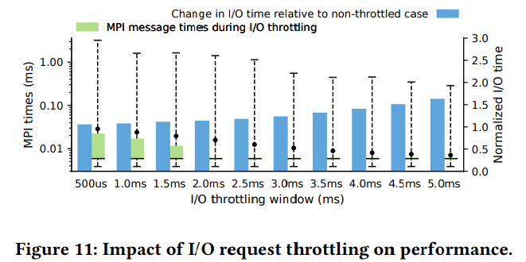
4. Mitigation strategies
Brown, Kevin A., et al. "Interference between I/O and MPI traffic on fat-tree networks." Proceedings of the 47th International Conference on Parallel Processing. 2018.
5. Conclusion
Throttling I/O Traffic
The characterization of the interference between I/O and MPI traffic on the fat-tree network proves that I/O traffic is less sensitive to interference than MPI traffic.
Intensive MPI jobs can slow the performance of certain I/O traffic by up to 1.9×, while the largest slowdown for MPI traffic is 7.6×.
Modern HPC systems typically run a larger percentage of MPI jobs than I/O jobs
I/O traffic - identified the presence of I/O-congestion threshold in various scenarios. This threshold varies based on the size of the request and the scale of the I/O jobs, and it was discovered to be an important cause of slowdowns for both I/O and MPI performance.
The process of regulating the rate at which I/O requests are sent or processed
Random-node job placement, isolated-target I/O server
I/O throttling is achieved by varying the time between initiating consecutive I/O requests => throttle window
MPI : improve
I/O : unchanged
1.3ms
Duration between the start times of 2 consecutive requests
3 mitigation strategies (job placement, I/O server placement, I/O throttling)
=> Can reduce interference and improve performance, especially for MPI jobs. => The placement strategies demonstrate how the architecture and routing of fat-tree networks can be exploited to isolate I/O traffic on a shared network.
I/O throttling can potentially be used to reduce MPI-I/O interference if a relatively small loss in I/O performance is acceptable.
Additionally, the I/O-congestion threshold may be an effective guide for choosing appropriate throttling windows.
Notes:
I/O throttling has been presented as a solution to reducing I/O congestion and preventing low-priority I/O workloads from monopolizing the system’s I/O bandwidth [14, 22].
Throttling I/O traffic refers to the process of regulating the rate at which I/O requests are sent or processed.
The random-node job placement and isolated-target I/O server placement are used for these results
Each I/O client writes 4.3 GB of total data, which is broken up into 4 MB units and sent to I/O servers in a round-robin manner.
I/O throttling is achieved by varying the time between initiating consecutive I/O requests
They refer to this gap as the throttle window, which is x-axis here. The throttle window represents the duration between the start times of two consecutive requests.
We find that the I/O completion time remains unchanged for all throttle windows below 2 ms while MPI performance begins to improve when the I/O throttle window is >1.5 ms.
With 3 ms throttling, the checkpointing time increases by only 18% while the average MPI latency improves by over 200%.
The 3 ms window results in an average I/O request time of 1.3 ms and an effective I/O interval of 1.7 ms, which is around the I/O-congestion threshold for 4 MB requests.
These results indicate that I/O throttling can potentially be used to reduce MPI-I/O interference if a relatively small loss in I/O performance is acceptable. Additionally, the I/O-congestion threshold may be an effective guide for choosing appropriate throttling windows.
---------------
For Conclusion,
Resource contention over the network can be a major issue for jobs whose performance depends on efficient inter-process communication and/or I/O operations.
Their characterization of the interference between I/O and MPI traffic on the fat-tree network proves that I/O traffic is less sensitive to interference than MPI traffic.
Nevertheless, Their results show that intensive MPI jobs can slow the performance of certain I/O traffic by up to 1.9×, while the largest slowdown for MPI traffic is 7.6×. Small I/O jobs with a more typical I/O traffic pattern reported a 18% slowdown.
This is important because modern HPC systems typically run a larger percentage of MPI jobs than I/O jobs.
For I/O traffic, we identified the presence of I/O-congestion threshold in various scenarios. We found that this threshold varies based on the size of the request and the scale of the I/O jobs, and it was discovered to be an important cause of slowdowns for both I/O and MPI performance.
In order to mitigate the impact of I/O-MPI interference, we presented and evaluated three different strategies: job placement, I/O server placement, and I/O throttling. We found that each of these strategies can reduce interference and improve performance, especially for MPI jobs. The placement strategies demonstrate how the architecture and routing of fat-tree networks can be exploited to isolate I/O traffic on a shared network.
---------------
this paper characterizes the effects of interference between MPI and I/O traffic on the performance of each of these traffic types.

Slide 14
Thank You ☺

